Slide 1
Housing Price EDA project
Exploratory Data Analysis (EDA)/nBy:monika

Slide 2
introduction
This project is based on Exploratory data Analysis (EDA) of housing price data.the dataset contains information related to different features of house and their prices. EDA is used to understand the structure of the data ,identify patterns , and discover trend python libraries such as pandas, matplotlib and seaborn are used for data analysis and visualizations.
0

Slide 3
Project objective
The main objectives of this project are:
To analysis housing price data
To identify important features affecting house price
To clean and prepare the dataset
To visualize data using graph and charts

Slide 4
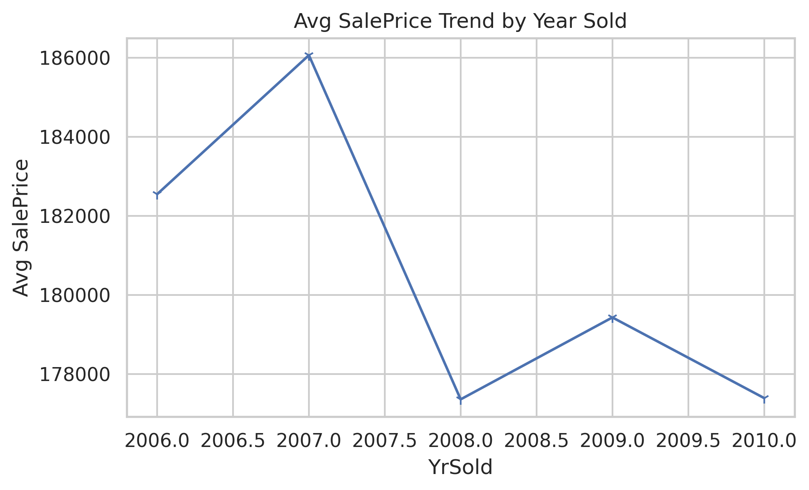

Slide 5
Data preprocessing
Handling missing values
Removing duplicate entries
Cleanings inconsistent data
Encoding categorical variable

Slide 6
Key insights
House quality has a strong impact on saleprice
Living area is directly related to house price
Sale price distribution is slightly right skewed

Slide 7
Tools & technologies used
Python
Pandas
Numpy
Matplotlib
Seaborn
Google colab

